Slide 1
Applied Statistical Modelling 1
Linear Regression
Prof.ssa Chiara Seghieri
Laboratorio di Management e Sanità, Istituto di Management, L’EMbeDS
Scuola Superiore Sant’Anna, Pisa
c.seghieri@santannapisa.it
c.tortu@santannapisa.it

Slide 2
Outline
Motivation and Intuition
The Linear Regression Model
Estimation of the Coefficients (OLS vs MLE)
Interpretation of coefficients
Regression Diagnostics
Goodness of fit
Multiple regression models: interpretation of coefficients
Correlation vs causation

Slide 3
1) Motivation and intuition

Slide 4
Motivation
We will model the relationship between a set of variables X_{s} and a single variable Y.
Examples: determinants of income, determinants of stock index,…
The main motivations for using the technique:
Analyze the specific relationships between the variables X_{s} and the Y.
Predict the “future” value of Y from the values of the variables X_{s}

Slide 5
Regression model
Relation between variables where changes in some variables may “explain” changes in other variables.
Explanatory variables (X₁, X₂, X₃,…) are termed the independent variables and the variable to be explained is termed the dependent variable (Y).
We can describe how variables are related using a mathematical function. This function is called a model.
Y=f(x_{1,} x_{2, …,} x_{s} )
N.B Some of these variables may be either unobservable or unimpactful on y.

Slide 6
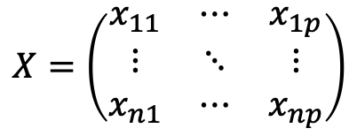
Notation
N: population size, number of observations in the population
n: sample size, number of observations in the sample
p: number of independent variables
x_{ij}: value of the j variable for the observation i, where i=1,2,…,n and j=1,2,…,p
yi: value of the dependent variable for the observation i, where i=1,2,…,n

Slide 7
To sum up
Regression model estimates the nature of the relationship between the independent and dependent variables.
Specifically, it allows researchers to understand
Size of the relationship.
Strength of the relationship.
Statistical significance of the relationship.
A
B
C

Slide 8
Simple and multivariate models
(Education) x y (Income)
(Education) x₁
(Sex) x₂
(Experience) x₃
(Age) x₄
Bivariate or simple regression model
Multivariate or multiple regression model
y (Income)

Slide 9
Types of Regression Models
1 Explanatory
Regression
2+ Explanatory
Variable
Models
Variables
Simple
Multiple
Non-
Non-
Linear
Linear
Linear
Linear
Notes:
24
This teleology is based on the number of explanatory variables & nature of relationship between X & Y.

Slide 10
2) Simple Linear Regression Model
Let’s start from an analysis for a quantitative response and a single quantitative explanatory variable.
Notes:
26

Slide 11
What is “Linear”?
Remember this: y=mx+b?
y
Change in y
b
intercept
Change in x
x
m=slope=change in y/change in x= (y₂-y₁)/(x₂-x₁)
The term linear is referred to the coefficients, not to the x
It is a deterministic mathematical relationship! we know the exact value of y just by knowing the value of x. This is unrealistic in almost any natural process!
Notes:
A slope of 2 means that every 1-unit change in X yields a 2-unit change in Y.

Slide 12
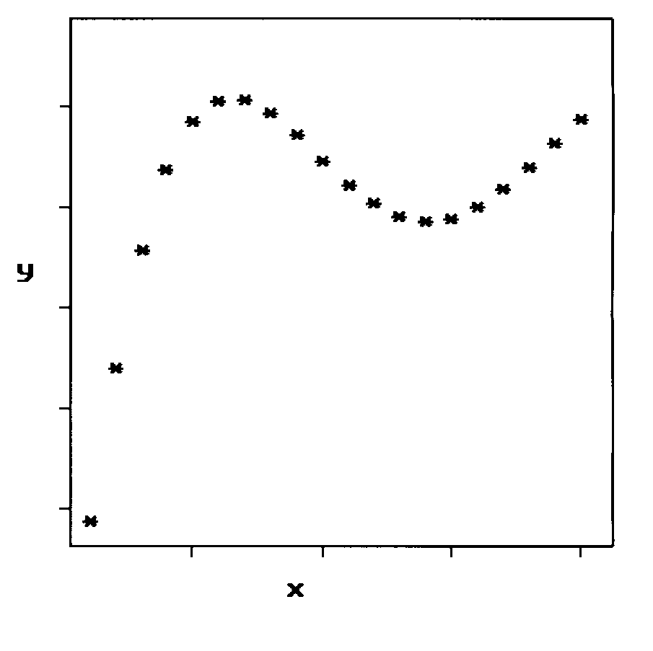
Nonlinear relationship:

Slide 13
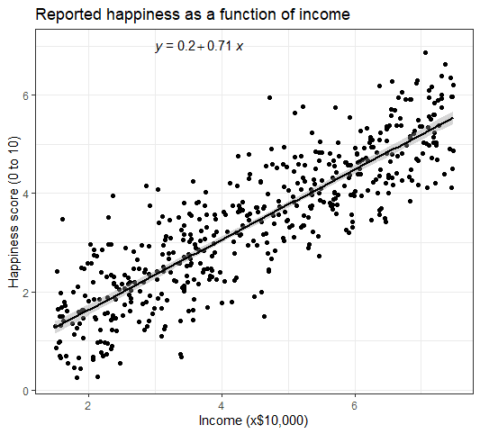
Generally social & real-world data do not fall on a straight line. For example, if we took family income (x), this value would provide some useful information about food expenditures of a family (y). However, the prediction would be far from perfect, since other factors play a role in deciding the level of expenditures. It's more common for data to appear as a cloud of points.
Linear regression is the statistical method for fitting a line to data where the relationship between two variables, x and y, can be modelled by a straight line with some error.
Notes:
In each of these examples,
we will have some uncertainty regarding our estimates of the model parameters, 0 and 1. For
instance, we might wonder, should we move the line up or down a little, or should we tilt it more
or less? As we move forward in this chapter, we will learn about criteria for line-tting, and we will
also learn about the uncertainty associated with estimates of model parameters.

Slide 14
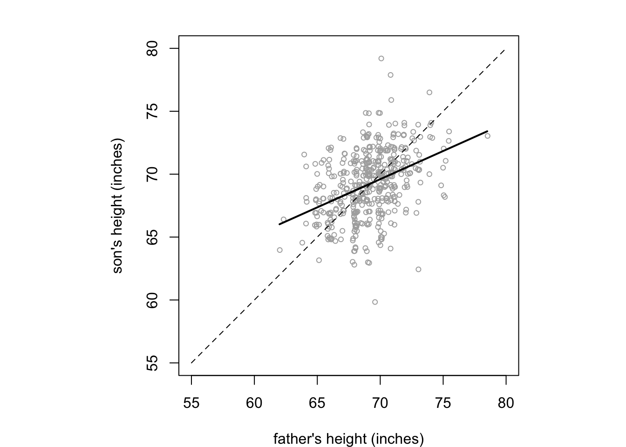

Slide 15
The relationship between the response Y and the predictor X can be written in general form as:
Y=f(X)+ε
f is some fixed but unknown function of X, is the systematic information that X provides about Y,
ε is the random error term which is independent of X and has mean zero, it cannot be predicted by using X and might contain unmeasured variables that are useful in predicting Y and/or unmeasurable variation (i.e. subjective feeling).
The idea is to estimate f. Broadly speaking, there can be parametric or non-parametric methods. The first start making an assumption about the functional form (or shape) of f, the latter do not make any assumption about the form of f.

Slide 16
If f is approximated by a linear function we have the general form of the simple linear regression (population regression model) model is:
Y=β₀+β₁X+ε
For an individual observation: y_{i}=β₀+β₁x_{i}+ε_{i}
Where:
β₀ is the population intercept, expected value of Y when X=0
β₁ is the population slope, average increase in Y associated with one unit increase in X
ε is the random error term, independent of X, mean zero what we miss with this simple model (other variables, measurement errors..)
For each value of x the population mean of Y (over all of the subjects who have that particular value “x” for their explanatory variable):
E(Y|x)=f(x)

Slide 17
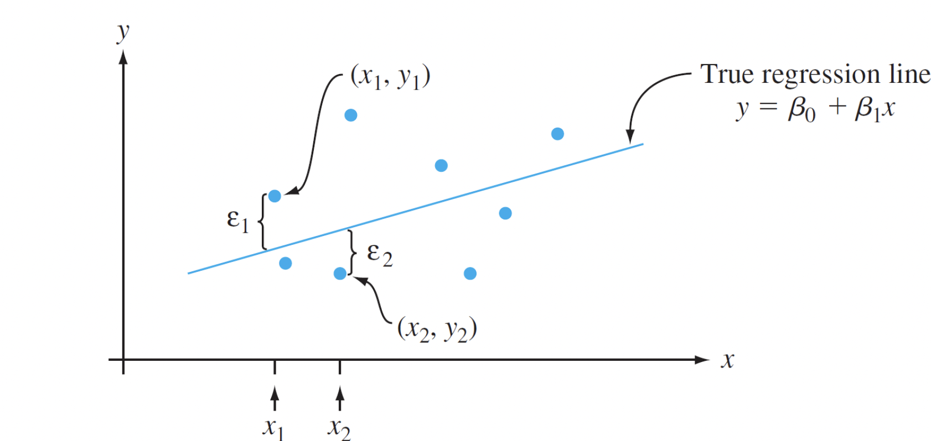
Population regression line
E(Y|x)=f(x)

Slide 18
Assumptions of the Model (1/2)
The relationship between X and Y is linear.
The error model underlying a linear regression analysis includes the assumptions Normality, equal spread, and independent errors.
for each particular x, if we have or could collect many subjects with that x value, their distribution around the population mean is Gaussian with a spread σ², that is the same value for each value
of x (and corresponding population mean of y). Of course, the value of σ² is an unknown parameter, and we can make an estimate of it from the data.
Sy/x
Sy/x
Sy/x
Sy/x
Sy/x
Sy/x
Notes:
If, for example, x = age of a child and y = vocabulary size,
then μY|5 is the average vocabulary size for all 5-°©year-°©old
children in the population, and σ 2
Y| 5 describes the amount
of variability in vocabulary size for this part of the
population.

Slide 19
Assumptions of the Model
- Linear: beta’s must not be in a transformed form. It is OK to transform x or Y , and that allows many non-linear relationships to be represented on a new scale that makes the relationship linear.
- Same spread around the regression line
Independent: the error (deviation of the true outcome value from the population mean of the outcome for a given x value) for one observational unit (usually a subject) is not predictable from knowledge of the error for another observational unit.
For example, in predicting time to reach a finish line from age, knowing that the first subject took 4 seconds longer than the mean of all possible
subjects with the same age should not tell us anything about how far the next subject’s time should be above or below the mean for their dose.

Slide 20
To make inference about these unknown population parameters, we must find an estimate for them. There are different ways to estimate the parameters from the sample. In this class, we will present the least squares method.

Slide 21
3) Estimation of Coefficients (OLS vs MLE)
Notes:
26

Slide 22
The linear model
By knowing this equation we can estimate values of y for a given value of x through the estimation of the coefficients β₀ and β₁
The values of β₀, β₁, and σ² will almost never be known to an investigator.
Instead, sample data consists of n observed pairs (x₁, y₁), … , (x_{n}, y_{n}),
from which the model parameters and the true regression
line itself can be estimated.
Since the estimates are made based on the sample and not the entire population, the estimate will not be perfect, there will be residuals or errors

Slide 23
Estimating the Coefficients
Question: What should be considered a good line?
y
w
w
w
w
w
w w w w
w
w w
w w
w
x

Slide 24
The Least Squares (Regression) Line
A good line is one that minimizes the sum of squared differences between the points and the line.
In practice, we don’t try every possible line. We use calculus to
find the values of β₀ and β₁ that give the minimum sum of squared residuals. It says that we should choose as the best-fit line, that line which minimizes the sum of the squared residuals.
The sample data are only one of the possible determinations, that is, the one that was “extracted”
As the sample and, therefore, the available data change, the estimated regression line will also change.

Slide 25
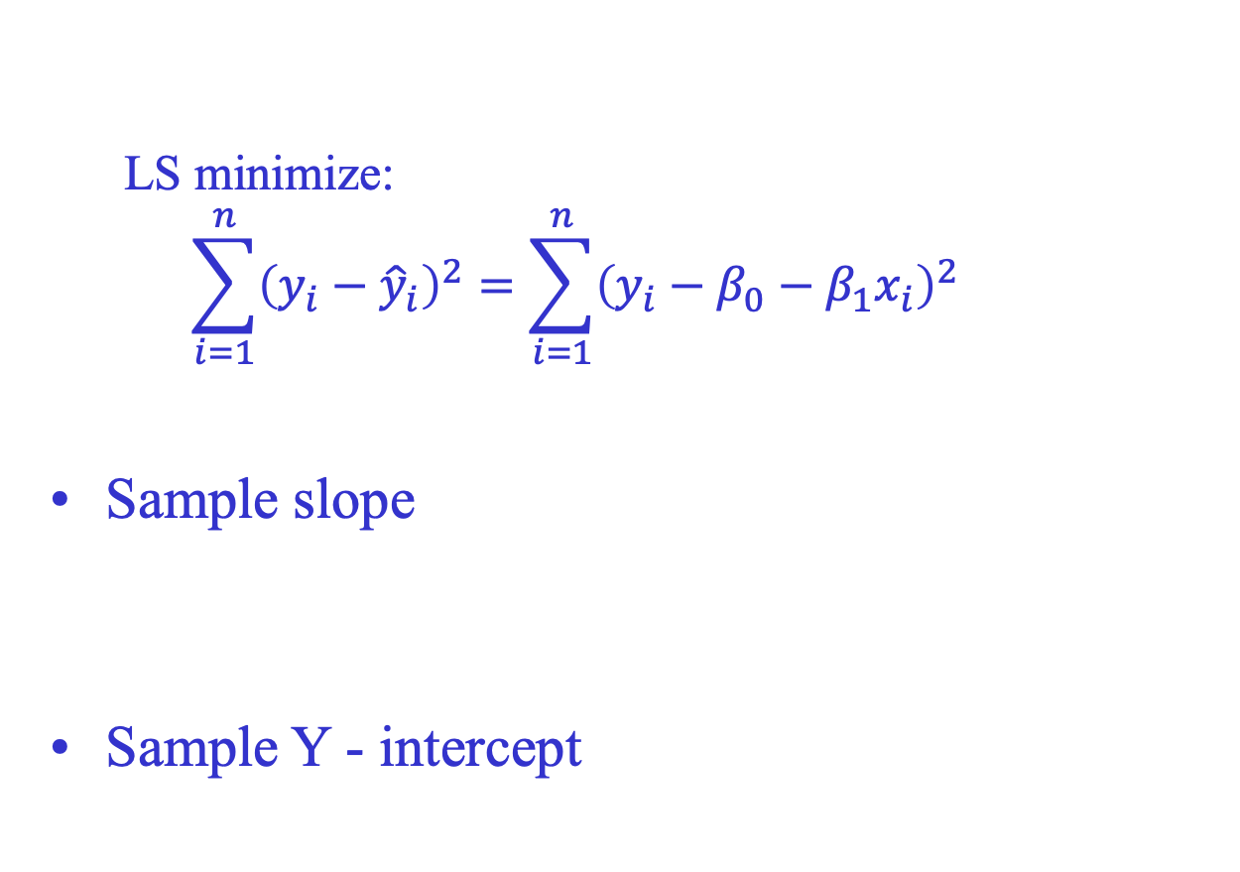
Least squares: Coefficient Equations

Slide 26
Residual
The difference between the observed value y_{i} and the corresponding fitted value.
A residual is the deviation of an outcome from the predicted mean value for all subjects with the same value for the explanatory variable.
Residuals are highly useful for studying whether a given regression model is appropriate for the data at hand.

Slide 27
e₂ - Difference between observed and predicted (for estimated regression).
Y, given X=40
Y, given X=80
Y, given X=120
ε₃ - Difference between observed and predicted (for true regression).
Estimated regression
True regression

Slide 28
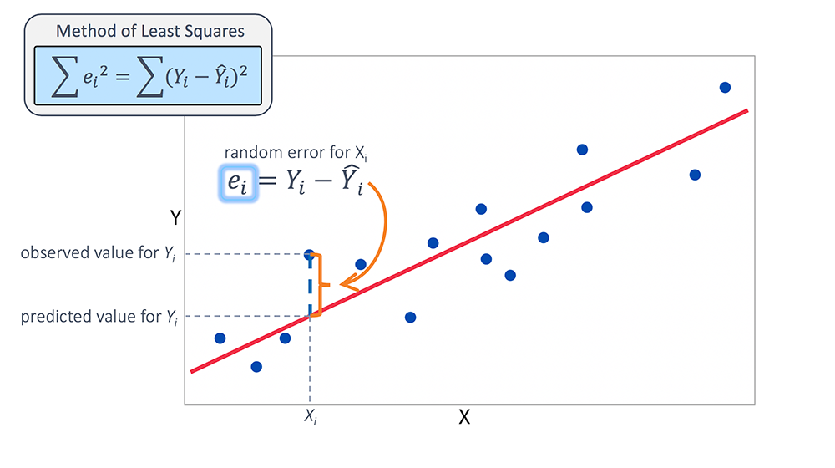
OLS: graphical intuition

Slide 29
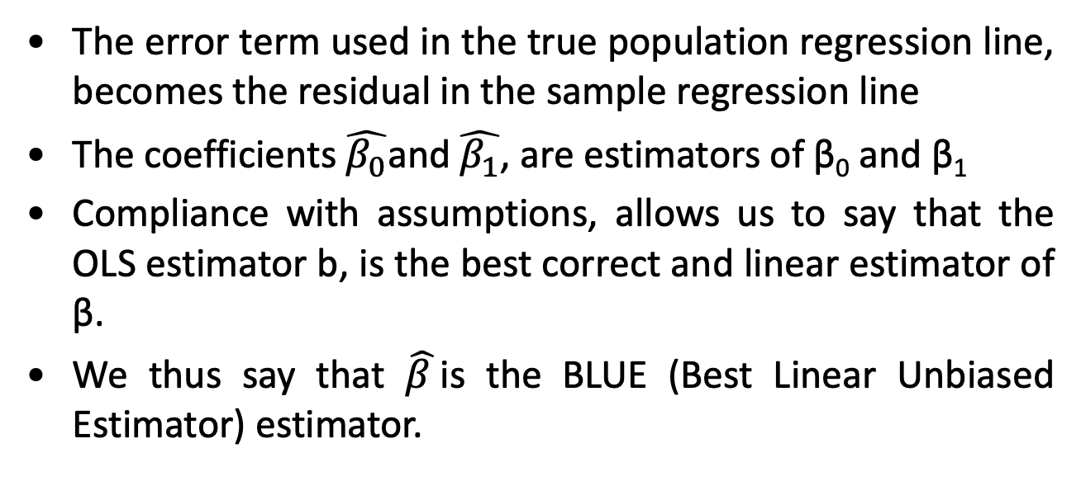
from population to sample regression line
The error term used in the true population regression line, becomes the residual in the sample regression line
The coefficients $\hat{β_{0}}$and $\hat{β_{1}}$, are estimators of β₀ and β₁
Compliance with assumptions, allows us to say that the OLS estimator b, is the best correct and linear estimator of β.
We thus say that $\hat{β }$is the BLUE (Best Linear Unbiased Estimator) estimator.

Slide 30
Best Linear Unbiased Estimate (BLUE)
If the following assumptions are met:
The Model is
Linear
Additive
The regression error term is
normally distributed
has an expected value of 0
errors are independent
homoscedasticity
Characteristics of OLS if sample is probability sample
Unbiased
Efficient
Consistent
BLUE (Best Linear Unbiased Estimator)

Slide 31
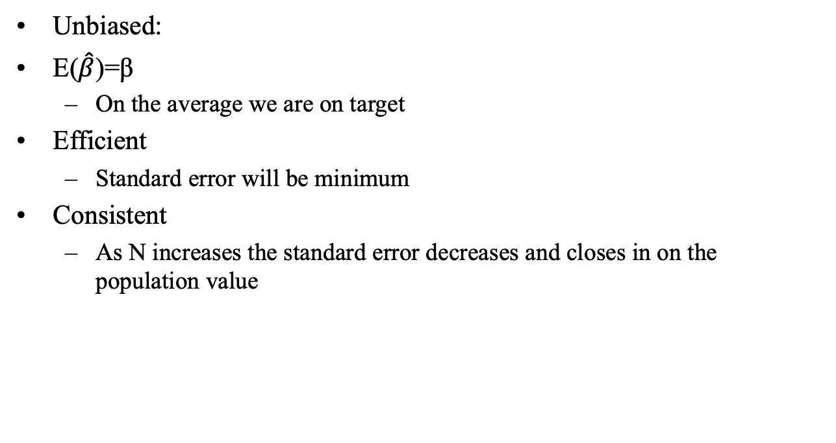
The Three Desirable Characteristics

Slide 32
Note that:
It is sufficient for the unbiasedness of the OLS estimator that the error terms have zero mean and are independent of all explanatory variables, even in the presence of autocorrelation and heteroschedasticity.
In the presence of autocorrelation and heteroschedasticity the OLS estimator can still be correct and consistent, but only relatively efficient (it is no longer BLUE)

Slide 33
In these cases, the OLS estimator, although correct, is not the best
Two possibilities open up at this point:
1] One can derive a new estimator (GLS or weighted least squares) that is BLUE
2] One can continue to use the OLS estimator, correcting the standard errors to admit the possibility of heteroschedasticity and/or autocorrelation

Slide 34
….otherwise
Finally, remember that in many cases the presence of heteroschedasticity and/or autocorrelation, indicates incorrect specification of the model.
Therefore, one can intervene in another way, namely reconsidering the model.

Slide 35
4) Interpretation of Coefficients

Slide 36
Interpretation of coefficients
^
1. Slope (β₁)
Estimated change (increase or decrease) of Y for Each 1 Unit Increase in X
If β₁ = 2, then on average increase by 2 for Each 1 Unit Increase in X
^

Slide 37
Interpretation of coefficients
^
2. Y-Intercept (β₀)
Average Value of Y When X = 0 (when it makes sense that X=0)
if β₀ = 4, then Average Y Is Expected to Be 4 When X Is 0
^

Slide 38
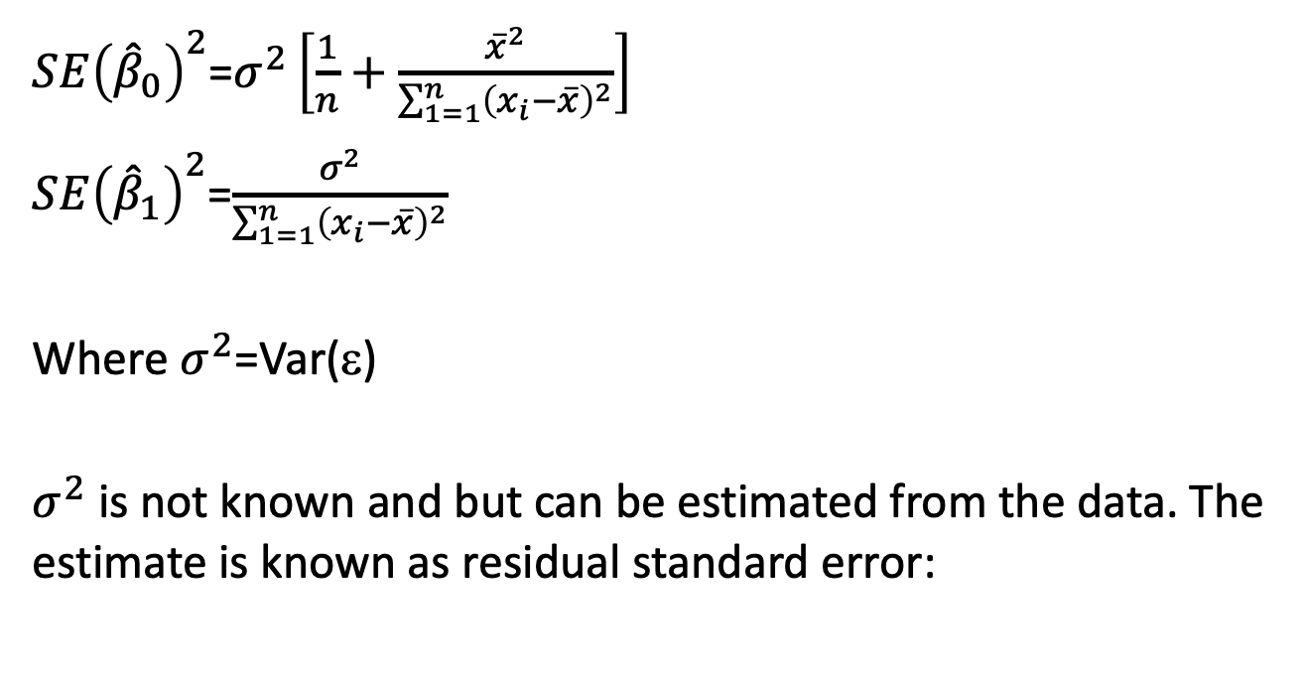
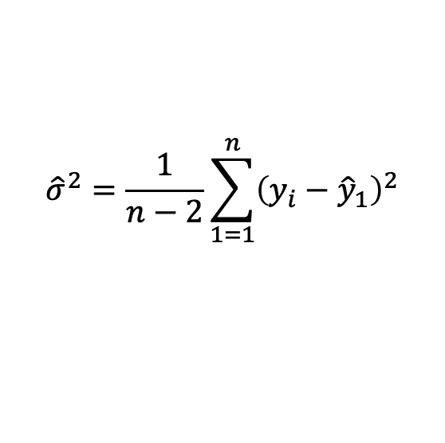
How close are the estimates of the parameters to the true values?
Notes:
For these formula to be valid we need to assume that the errors for each observation have common variance and are uncorrelated

Slide 39
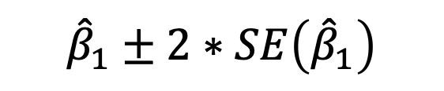
SE can be used in confidence interval (CI) formulas and hypothesis testing procedures:
(Thanks to the normality assumption of the errors!!)

Slide 40
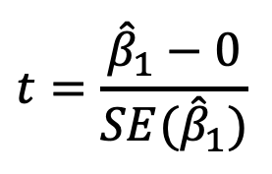
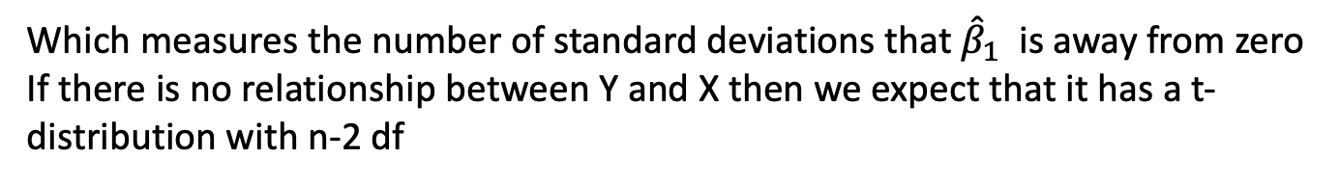
Testing the Slope
We can draw inference by testing:
H₀: β₁ = 0
H₁: β₁ = 0 (or < 0,or > 0)
We need to determine whether the estimate is sufficienty far from zero.
In practice we compute the t statistic:

Slide 41
The model in STATA
Sample: 20 cities in US; Y=homicide rate, X=% of families below the poverti line
reg homic poor
The regression model is:
Homicide rate = - 0.82 + 0.94 (poor families)

Slide 42
Interpretation and significance of the coefficients
The average city homicide rates rise by 0.94 with each 1-point increase in the percentage of families below poverty
The constant estimate implies that the average homicide rate should equal –0.8 in cities with 0 percent below poverty.
That interpretation makes no sense, because we have no cities without poverty. Despite the constant term is important for providing simply interpretation of the regression output, the regression line may yield unreasonable results when projected beyond the X range of the data.

Slide 43
Interpretation and significance of the coefficients
t test: it verifies the significance of each single parameter estimate. It is based on the two hypotheses:
H0: β=0 versus H1: β≠0
→ each coefficient is significantly different from 0.
P>|t| is the P-value, i.e. the estimated probability of a Type I error associated to the test statistic: the null is rejected if the P-value is lower than the chosen size (5%). In doing so, we make an error less than 5 times over 100. In this case, the coefficient of β is statistically significant in explaining the city homicide rates (P-value of ‘poor’ 0.023 < 0.05)

Slide 44
Together with the parameter estimates also standard errors are reported.
SE are estimated standard deviations of the corresponding sampling distributions and gives an idea of the scale of the variability of the estimate of the coefficient around the true, unknown value if we repeat the whole experiment many times.

Slide 45
4) Goodness of fit

Slide 46
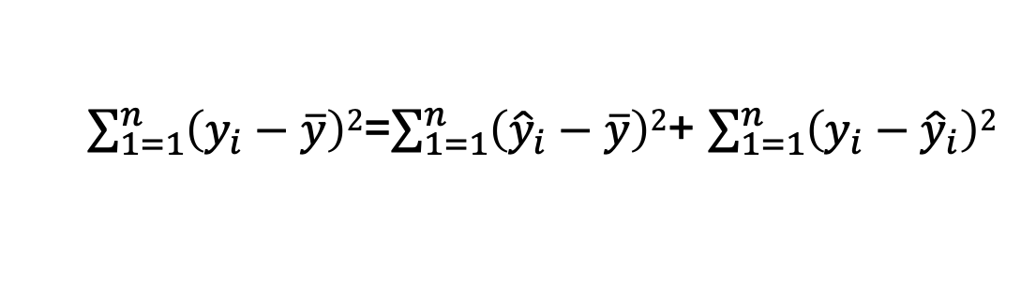
The fit of the model
The regression model
Explained in part by
Overall variability in y
Remains, in part, unexplained
The error
Regression Sum of Square
Error Sum of Square
Total Sum of Square
Due to th epresence of the error term in the regression equation we would not be able to perfectly predict
Y from X, if the sum of square of the error is quite large then the model does not fit the data well

Slide 47
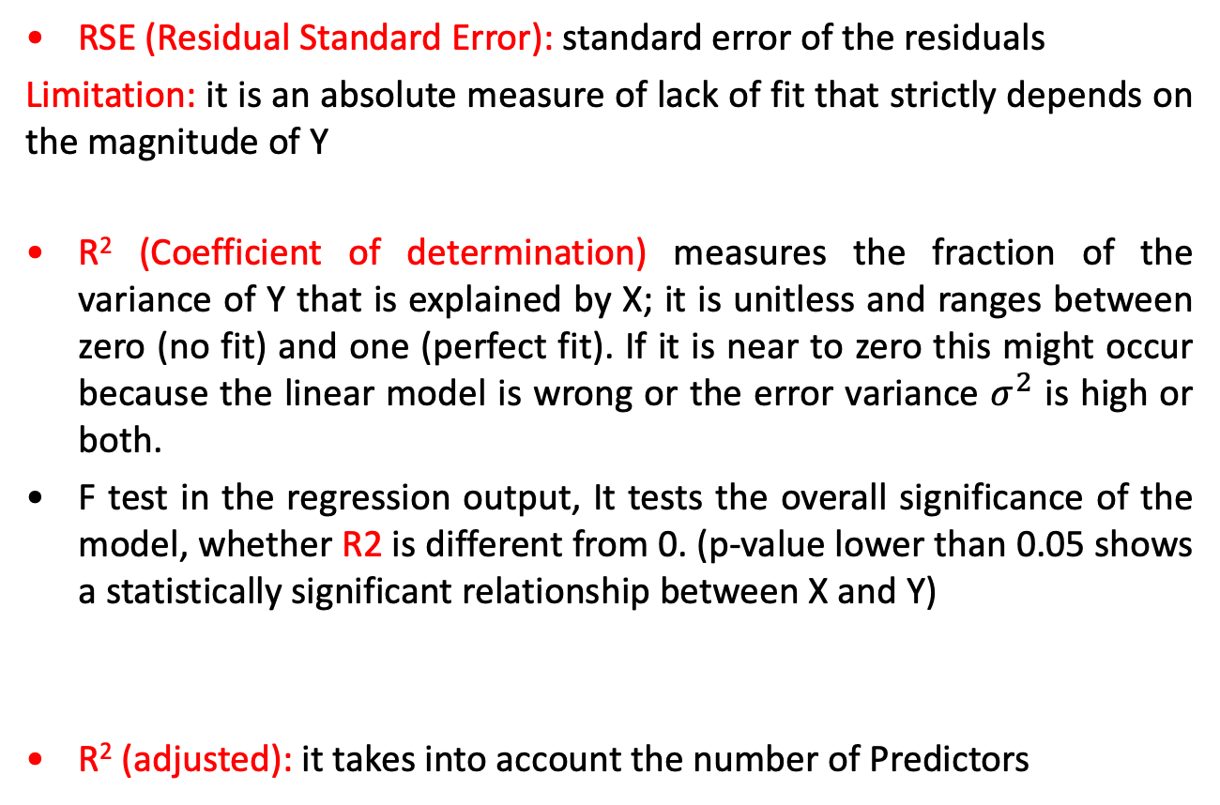
The fit of the model
Notes:
Prob > F = 0.0233 : p-value of the model. It tests the overall significance of the model, whether R2 is different from 0. (p-value lower than 0.05 shows a statistically significant relationship between X and Y)

Slide 48
5) Regression diagnostics

Slide 49
Assumptions for Simple Linear Regression
Linearity: The relationship between X and Y must be linear.Check this assumption by examining a scatterplot of x and y.
Independence of errors: There is not a relationship between the residuals and the Y variable; in other words, Y is independent of errors. Check this assumption by examining a scatterplot of “residuals versus fits”; the correlation should be approximately 0. In other words, there should not look like there is a relationship.
Normality of errors: The residuals must be approximately normally distributed. Check this assumption by examining a normal probability plot; the observations should be near the line. You can also examine a histogram of the residuals; it should be approximately normally distributed.
Equal variances: The variance of the residuals is the same for all values of X. Check this assumption by examining the scatterplot of “residuals versus fits”; the variance of the residuals should be the same across all values of the x-axis. If the plot shows a pattern (e.g., bowtie or megaphone shape), then variances are not consistent, and this assumption has not been met.
Notes:
In addition to the three error model assumptions just discussed, we also assume
“independent errors”. This assumption comes down to the idea that the error
(deviation of the true outcome value from the population mean of the outcome for a
given x value) for one observational unit (usually a subject) is not predictable from
knowledge of the error for another observational unit. For example, in predicting
time to complete a task from the dose of a drug suspected to affect that time,
knowing that the first subject took 3 seconds longer than the mean of all possible
subjects with the same dose should not tell us anything about how far the next
subject’s time should be above or below the mean for their dose
Fortunately regression and ANOVA are both quite
robust to deviations from the Normality assumption, and it is OK to use discrete
or continuous outcomes that have at least a moderate number of different values,
e.g., 10 or more. It can even be reasonable in some circumstances to use regression
or ANOVA when the outcome is ordinal with a fairly small number of levels.

Slide 50
Residual
The difference between the observed value y_{i} and the corresponding fitted value.
A residual is the deviation of an outcome from the predicted mean value for all subjects with the same value for the explanatory variable.
Residuals are highly useful for studying whether a given regression model is appropriate for the data at hand.

Slide 51
e₂ - Difference between observed and predicted (for estimated regression).
Y, given X=40
Y, given X=80
Y, given X=120
ε₃ - Difference between observed and predicted (for true regression).
Estimated regression
True regression

Slide 52
Conditions for Regression Inference
The simple linear regression model, which is the basis for inference, imposes several conditions.
We should verify these conditions before proceeding with inference.
The conditions concern the population, but we can observe only our sample.

Slide 53
Regression Diagnostics
The three conditions required for the validity of the regression analysis are:
the error variable is normally distributed.
the error variance is constant for all values of x.
The errors are independent of each other.
How can we diagnose violations of these conditions?

Slide 54
Regression Diagnostics
How can we diagnose violations of these conditions?
Residual Analysis, that is, examine the differences between the actual data points and those predicted by the linear equation.
A plot of all residuals on the y-axis vs. the predicted values on the x-axis, called a residual vs. fit plot, is a good way to check the linearity and equal variance assumptions.
A quantile-normal plot of all of the residuals is a good way to check the Normality assumption.

Slide 55
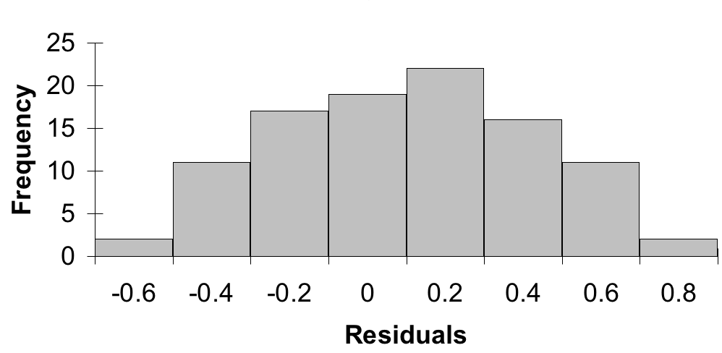
Nonnormality
We can take the residuals and put them into a histogram to visually check for normality…
…we’re looking for a bell shaped histogram with the mean close to zero.

Slide 56
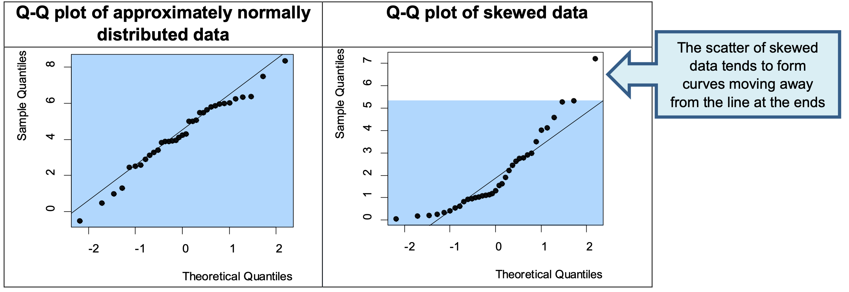
Nonnormality
The Q-Q plot is an alternative graphical method of assessing normality to the histogram and is easier to use when there are small sample sizes. It compares the observed quantile with the theoretical quantile of a normal distribution. The scatter compares the data to a perfect normal distribution. The scatter should lie as close to the line as possible with no obvious pattern coming away from the line for the data to be considered normally distributed.

Slide 57
Nonnormality
There are also specific test for which could be used in conjunction with either a histogram or a Q-Q plot.
The Kolmogorov-Smirnov test and the Shapiro-Wilk’s W test whether the underlying distribution is normal. Both tests are sensitive to outliers and are influenced by sample size:
For smaller samples, non-normality is less likely to be detected but the Shapiro-Wilk test should be preferred as it is generally more sensitive
For larger samples (i.e. more than one hundred), the normality tests are conservative and the assumption of normality might be rejected too easily.

Slide 58
Nonnormality
The Shapiro-Wilk test for normality. It answers the question: is there enough evidence for non-normality to overthrow the null hypothesis (the null hypothesis is that the distribution of the residuals is normal). In stata the command is swilk.

Slide 59
Nonnormality
Regression Inference is robust against moderate lack of Normality. On the other hand, outliers and influential observations can invalidate the results of inference for regression. What to do?
Transform the dependent variable (repeating the normality checks on the transformed data): Common transformations include taking the log or square root of the dependent variable
Use non-parametric methods.

Slide 60
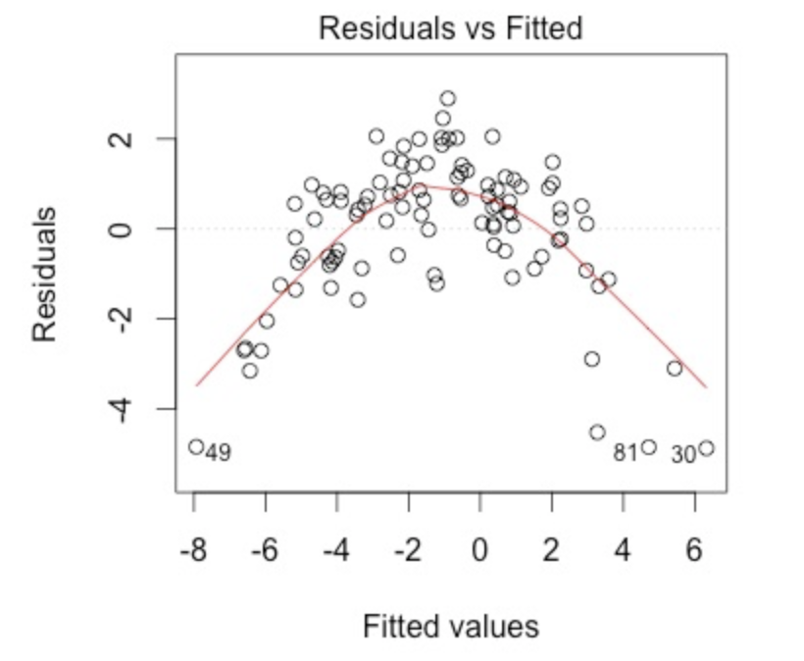
The plot of residuals versus predicted values is useful for checking the assumption of linearity and homoscedasticity.
If the model does NOT meet the linear model assumption, we would see our residuals take on a defined shape or a distinctive pattern

Slide 61
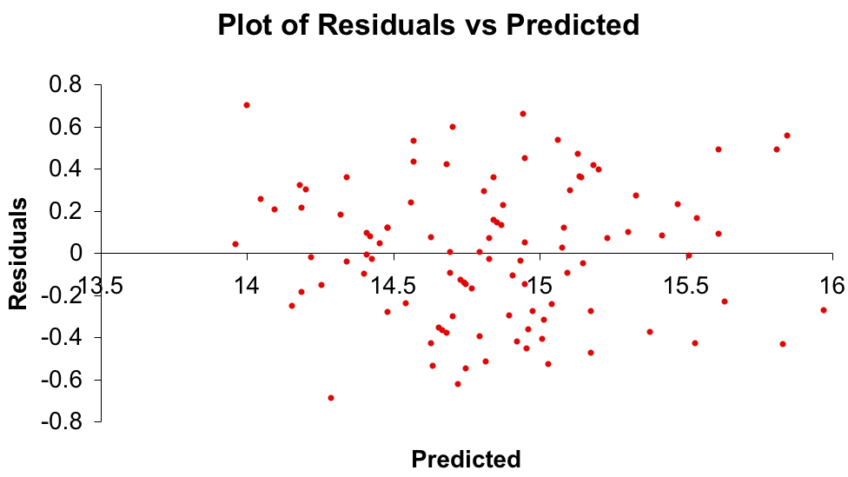
Heteroscedasticity
When the requirement of a constant variance is violated we have a condition of heteroscedasticity. Heteroscedasticity results in biased standard errors.
Diagnose heteroscedasticity by plotting the residual against the predicted y.
there doesn’t appear to be a change in the spread of the plotted points, therefore no heteroscedasticity

Slide 62
Heteroscedasticity
+
+
+
+
+
+
+
+
+
+
+
+
+
+
+
+
+
+
+
+
+
+
+
+
+
+
+
+
+
+
+
+
+
+
+
+
+
+
+
+
+
+
+
+
+
+
+
^
The spread increases with y

Slide 63
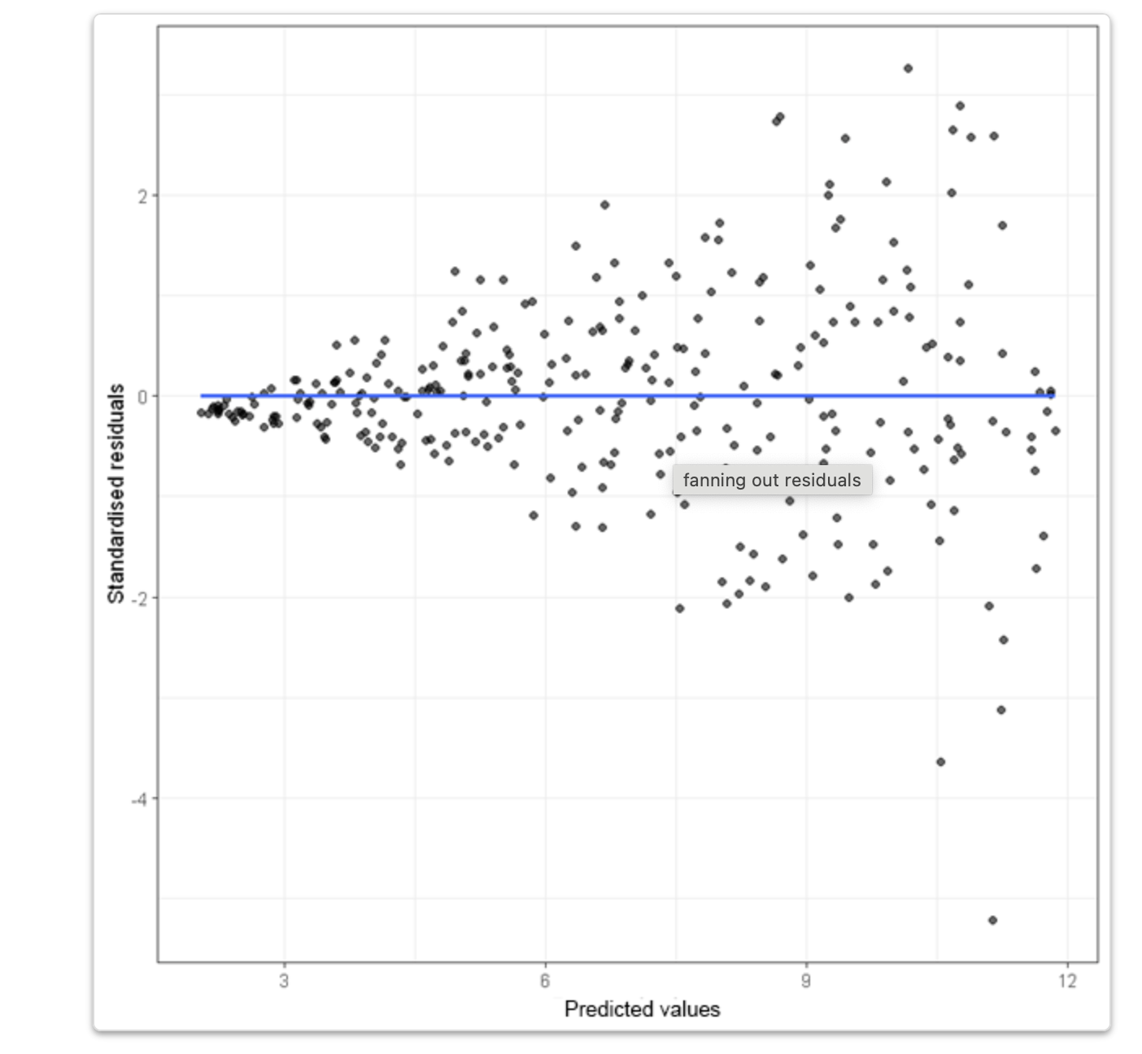
Standardized residual: residual divided by an estimate of its standard deviation. They quantify how large the residuals are in standard deviation units, and therefore can be easily used to identify outliers

Slide 64
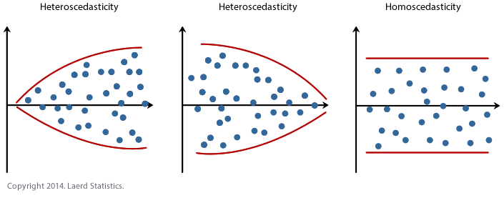
Heteroscedasticity

Slide 65
Heteroscedasticity
Another way to test for heteorscedasticity is the Breusch-Pagan test. The null hypothesis is that residuals are homoskedastic.
In stata the command is estat hettest (after the regression)
If the test statistic is significant, then there is unspecified heteroscedasticity, which you can correct by estimating with the robust option to the regress command and/or you may use weighted least squares instead of OLS. You may use both WLS and robust in the same model.
According to Berry and Feldman (1985) and Tabachnick and Fidell (1996) slight heteroscedasticity has little effect on significance tests; however, when heteroscedasticity is marked it can lead to serious distortion of findings and seriously weaken the analysis thus increasing the possibility of a Type I error.

Slide 66
Non-Independence of Errors
A time series is constituted if data were collected over time.
Examining the residuals over time, no pattern should be observed if the errors are independent.
When a pattern is detected, the errors are said to be autocorrelated.
Autocorrelation can be detected by graphing the residuals against time.

Slide 67
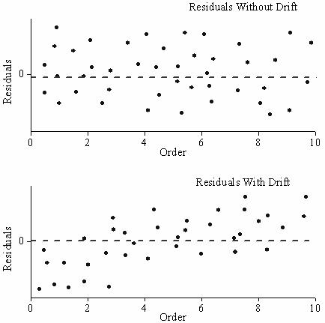
Non-Independence of Errors

Slide 68
Issues in model specification
Additionally, there are issues that can arise during the analysis that, while strictly speaking are not assumptions of regression, are none the less, of great concern to data analysts Model specification – the model should be properly specified (including all relevant variables, and excluding irrelevant variables)
Multicollinearity – predictors that are highly related to each other and both predictive of your outcome, can cause problems in estimating the regression coefficients.
Unusual and Influential Data
Outliers: observations with large residuals (the deviation of the predicted score from the actual score).
Leverage: measures the extent to which the predictor differs from the mean of the predictor.
Influence: observations that have high leverage and are extreme outliers, changes coefficient estimates drastically if not included
Notes:
Influence - individual observations that exert undue influence on the coefficients

Slide 69
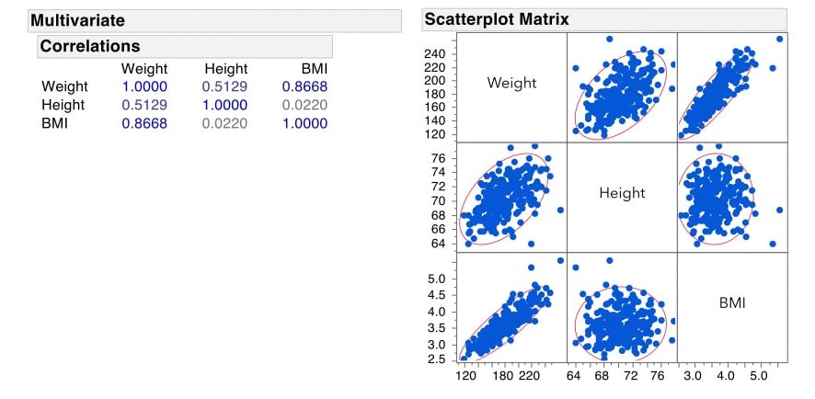
Issues in model specification

Slide 70
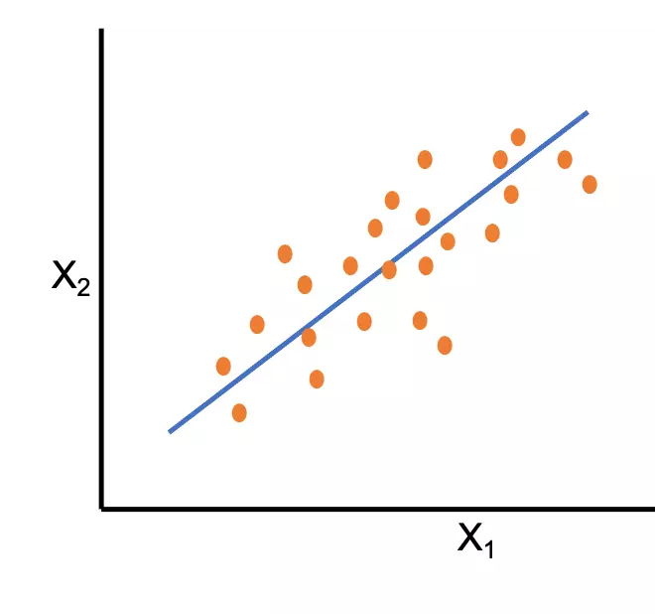
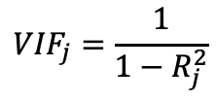
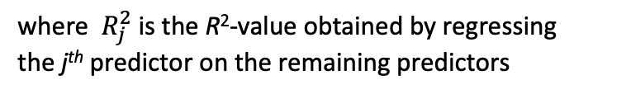
Issues in model specification
vif - variance inflation factor, a measure of potential multicollinearity.
the variance inflation factor for the j^{th} predictor is:
A VIF of 1 means that there is no correlation among the j^{th} predictor and the remaining predictor variables, and hence the variance of b_{j} is not inflated at all. The general rule of thumb is that VIFs exceeding 4 warrant further investigation, while VIFs exceeding 10 are signs of serious multicollinearity requiring correction.

Slide 71
Influential Points
If a single observation (or small group of observations) substantially changes your results, you would want to know about this and investigate further. There are three ways that an observation can be unusual.
Outliers: In linear regression, an outlier is an observation with large residual. In other words, it is an observation whose dependent-variable value is unusual given its values on the predictor variables. An outlier may indicate a sample peculiarity or may indicate a data entry error or other problem.
Leverage: An observation with an extreme value on a predictor variable is called a point with high leverage. Leverage is a measure of how far an observation deviates from the mean of that variable. These leverage points can have an effect on the estimate of regression coefficients.
Influence: An observation is said to be influential if removing the observation substantially changes the estimate of coefficients. Influence can be thought of as the product of leverage and outlierness.

Slide 72
Outliers
An outlier is an observation that is unusually small or large.
Several possibilities need to be investigated when an outlier is observed:
There was an error in recording the value.
The point does not belong in the sample.
The observation is valid.
Identify outliers from the scatter diagram.

Slide 73
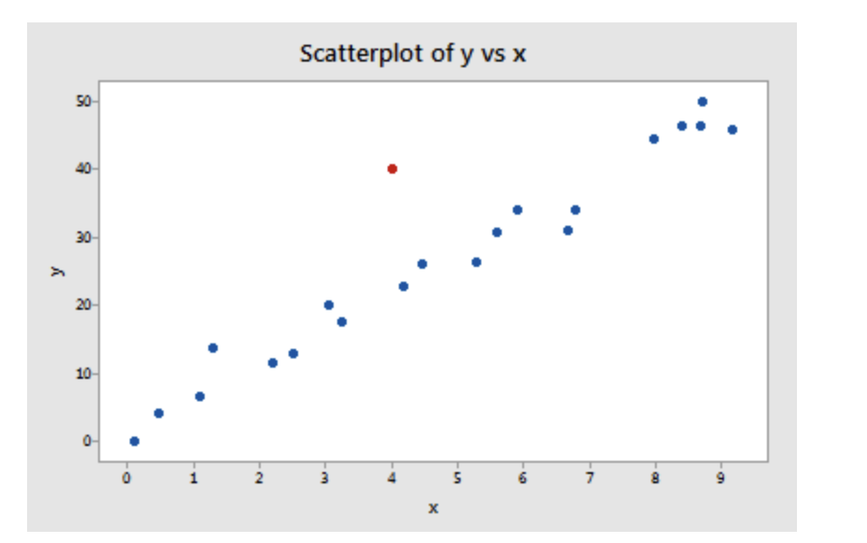
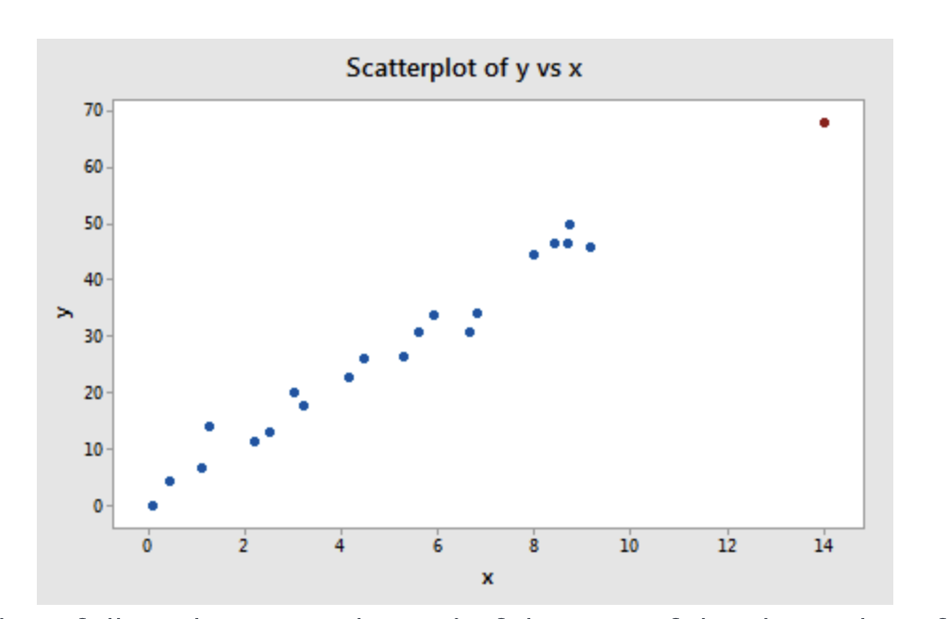
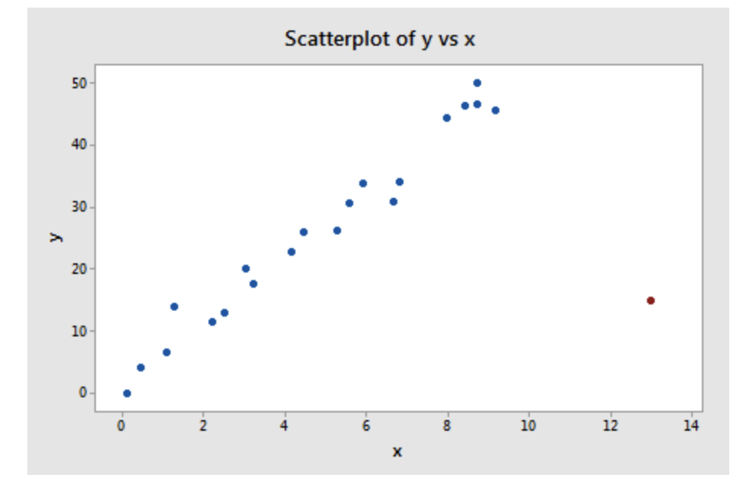
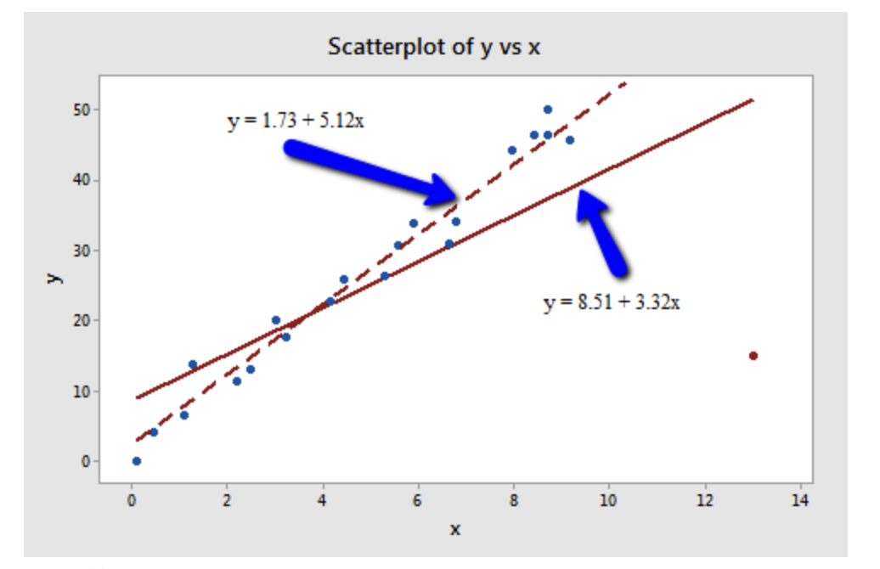

Slide 74
Not every outlier or high-leverage data point strongly influences the regression analysis. The researcher should always determine if the regression analysis is highly influenced by one or more data points. Of course, the easy situation occurs for simple linear regression, when we can rely on simple scatter plots to elucidate matters. In the multiple regression situation, we have to rely on various measures to help us determine whether a data point is an outlier, high leverage, or both. Once we've identified such points we then need to see if the points are actually influential.

Slide 75
Outlier removal is straightforward in most statistical software. However, it is not always desirable to remove outliers.
We can then look at the standardized residual for each observation, we can use this fact to identify “large” residuals. For example, values more extreme than 2 may be a problem .
Notes:
standardized residuals greater than 2 in magnitude should only happen approximately 5 percent of the time

Slide 76
Leverage: A leverage point is defined as an observation that has a value of x that is far away from the mean of x. These leverage points can have an effect on the estimate of regression coefficients. A leverage point will inflate the strength of the regression relationship by both the statistical significance (reducing the p-value to increase the chance of a significant relationship) and the practical significance (increasing r-square).
Leverage - for measuring “unusualness” of x’s: A standardized version of the distance to the mean of the predictor for each individual predictor point.
Generally, a point with leverage greater than (2k+2)/n should be carefully examined. Here k is the number of predictors and n is the number of observations
Notes:
A single observation that is substantially different from all other observations can make a large difference in the results of your regression analysis. If a single observation (or small group of observations) substantially changes your results, you would want to know about this and investigate further. There are three ways that an observation can be unusual.
However, a leverage point will inflate the strength of the regression relationship by both the statistical significance (reducing the p-value to increase the chance of a significant relationship) and the practical significance (increasing r-square).

Slide 77
Influence: An observation is said to be influential if removing the observation substantially changes the estimate of coefficients. Influence can be thought of as the product of leverage and outlierness. Thus, influential points have a large influence on the fit of the model. One method to find influential points is to compare the fit of the model with and without each observation.
As our data point of interest has both high leverage and discrepancy, it should also have high influence
A common measure of influence is Cook’s Distance, a measure, for each observation, of the extent of change in model estimates when that particular observation is omitted.
Any observation that has Cook’s distance close to 1 or more, or that is substantially larger than other Cook’s distances (highly influential data points), requires investigation.
Notes:
A single observation that is substantially different from all other observations can make a large difference in the results of your regression analysis. If a single observation (or small group of observations) substantially changes your results, you would want to know about this and investigate further. There are three ways that an observation can be unusual.
Neither of these feature necessarily makes a data point influence a linear model. In fact, the influenceof a single data point is defined as its leverage × its discrepancy. This means that simply having high leverage or high discrepancy (outlier) is not always enough to change model parameters

Slide 78
Procedure for Regression Diagnostics
Develop a model that has a theoretical basis.
Gather data for the two variables in the model.
Draw the scatter diagram to determine whether a linear model appears to be appropriate.
Determine the regression equation.
Check the required conditions for the errors.
Check the existence of outliers and influential observations
Assess the model fit.
If the model fits the data, use the regression equation.

Slide 79
7) Multiple regression models: interpretation of coefficients

Slide 80
Multiple Linear Regression
More than one predictor…
y = b₀ + b₁x₁ + b₂x₂ + b₃x₃ + ... + b_{k}x_{k} + e
Additive (Effect) Assumption: The expected change in y per unit
increment in x_{j} is constant and does not depend on the value of any other predictor. This change in y is equal to b_{j}.
That is the amount of change in the outcome variable that would be expected per one unit change of the predictor, if all other variables in the model were held constant.

Slide 81
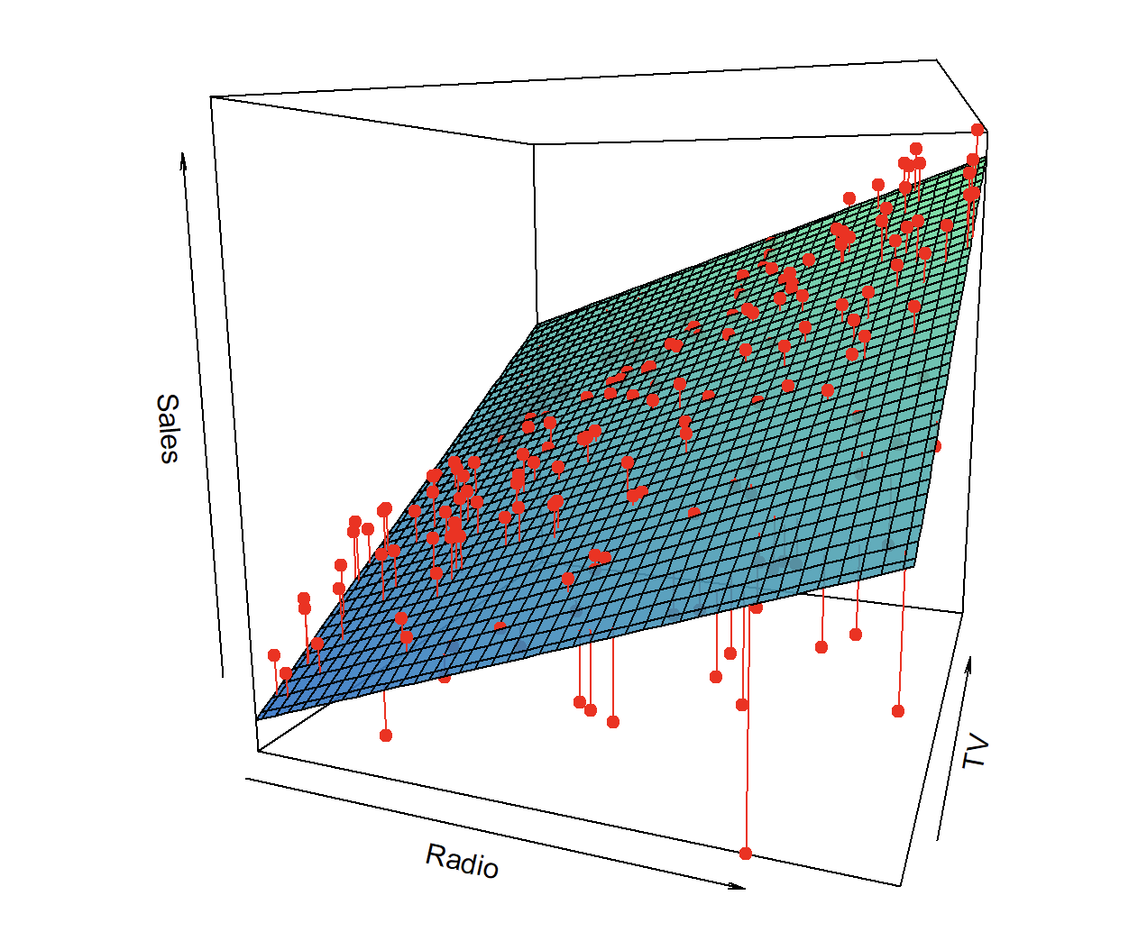
Y
X2
X1

Slide 82
Standardized Regression Coefficients
Regression slopes depends on the units of the independent variables
How do you compare how “strong” the effects of two variables if they have totally different units?
Example: Education, health status, income
Education measured in years, b = 2.5
Health status measured on 1-5 scale, b = .18
Which is a “bigger” effect? Units aren’t comparable
“standardized” coefficients

Slide 83
Standardized Regression Coefficients
Standardized Coefficients called “Betas” or Beta Weights” (is equivalent to Z-scoring all independent variables before doing the regression)
The unit is standard deviations and Betas indicate the effect a 1 standard deviation change in X_{j} on Y (an increase of 1 standard deviation in X results in a b standard deviation increase in Y)

Slide 84
Example:
Sample of 20 HHs, food consumption (Y) HH income (X₁).
The estimated model is
Y= expenditures * 1000 euros
X₁=HH income * 1000 euros
Now we include HH size (X₂)

Slide 85
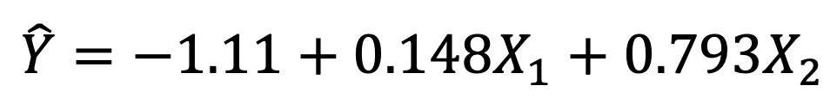
$$\hat{Y}=−1.11+0.148X_{1}+0.793X_{2}$$
on average, consumption expend. increase of 793 Euros yearly for an additional component in the HH, holding X₁ fixed
on average, consumption expend. increase, of 148 Euros each year for an increase of 1000 Euros of the income, holding X₂ fixed

Slide 86
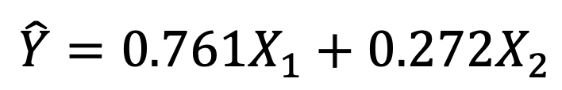
Standardized coefficients
$$\hat{Y}=0.761X_{1}+0.272X_{2}$$
Which variable is contributing more to explain the food expenditures?

Slide 87
How to make a prediction:
Estimate Y for a family with HH income 90000 € and HHsize = 5
BE CAREFUL: HH income is in €*1000, therefore X1= 90
Predicted expenditure 16.167 Euro

Slide 88
Dummy Variables
“Dummy” = a dichotomous variables coded to indicate the presence (1) or absence (0) of something.
First, create a separate dummy variable for all categories
Ex: Gender – make female & male variables
DFEMALE: coded as 1 for all women, zero for men
DMALE: coded as 1 for all men
Then: Include all but one dummy variables into a multiple regression model
If two dummies, include 1; If 5 dummies, include 4.

Slide 89
Dummy Variables
Example:
What if the case i is a male?
DFEMALE is 0 in case of male, so males are modeled as:
a + b₁AGE + e.

Slide 90
Dummy Variables
What if the case i is a female?
DFEMALE=1 and so females are modeled using a different regression line: (a+b₂) + b₁AGE + e
Thus, the coefficient of b₂ reflects difference in the constant for women.

Slide 91
Y
Same slopes b₁
Females
a + b₂
_{a}
Males
0
X1
0
a different constant generates a different line, either higher or lower. A positive coefficient (b) indicates that women are consistently higher compared to men (on dep. var.). A negative coefficient indicated women are lower
Notes:
68

Slide 92
Dummy Variables
A positive coefficient (b) indicates that women are consistently higher compared to men (on dep. var.)
A negative coefficient indicated women are lower
Example: If DFEMALE coeff = 1.2:
“Women are on average 1.2 points higher than men”.

Slide 93
Dummy Variables
What if you want to compare more than 2 groups?
Example: Race
Coded 1=white, 2=black, 3=other
Make 3 dummy variables and then, include two of the three variables in the multiple regression model.
The contrast is always with the category that was left out of the equation
If DFEMALE is included, the contrast is with males
If DBLACK, DOTHER are included, coefficients reflect difference in constant compared to whites.

Slide 94
Interactions
What if a variable has a different slope for two different sub-groups in your data?
Example: Income and Satisfaction with life – gender
Perhaps for men an extra euro increases their satisfaction a lot
Whereas for women each euro has a smaller effect on satisfaction (compared to men)
The slope of a variable (income) might differ across groups
More in general, an interaction occurs when an independent variable has a different effect on the outcome depending on the values of another independent variable.

Slide 95
Interactions
here women, have a less steep income-satisfaction relationship compared to men
Women = blue, Men = red
10
9
the slope for men and women differs.
8
7
6
5
The effect of income on satisfaction (X1 on Y) varies with gender (X2). This is called an “interaction effect”
4
3
2
SATISFACTION
1
0
0
20000
40000
60000
80000
100000
INCOME

Slide 96
Interactions
Examples of interaction:
Effect of education on income may interact with type of school attended (public vs. private)
Private schooling has bigger effect on income
Effect of aspirations on educational attainment interacts with poverty
Aspirations matter less if you don’t have money to pay for college

Slide 97
Interactions
Interaction effects: Differences in the relationship (slope) between two variables for each category of a third variable
Option #1: Analyze each group separately (stratify)
Look for different slope in each group
Option #2: Multiply the two variables of interest: (DFEMALE, INCOME) to create a new variable
Called: DFEMALE*INCOME
Add that variable to the multiple regression model.

Slide 98
Interactions
Example, Y is satisfaction
if the case i is male:
DFEMALE is 0, so b₂(DFEM*INC)=0 and males are modeled using the regression equation:
a + b₁X + e.

Slide 99
if the case i is female
DFEMALE is 1, so b₂(DFEM*INC) becomes b₂*INCOME, which is added to b₁
Females are then modeled using a different regression line: a + (b₁+b₂) X + e
Thus, the coefficient of b₂ reflects difference in the slope of INCOME for women.

Slide 100
Interactions
Interpreting interaction terms:
A positive b for DFEMALE*INCOME indicates the slope for income is higher for women vs. men
A negative effect indicates the slope is lower
Size of coefficient indicates actual difference in slope
Example: DFEMALE*INCOME, Coefficient = -.58 indicates that the slope of satisfaction and income is .58 points lower for females than for males

Slide 101
Interactions: continuous variables
Two continuous variables can also interact
Example: Effect of education and income on subjective well being
Multiply Education and Income to create the interaction term “EDUCATION*INCOME”
And add it to the model.

Slide 102
Interactions: continuous variables
Example: EDUCATION*INCOME: Coefficient = 2.0:
For each unit change in education, the slope of income – subj wellbeing increases by 2
Note: coefficient is symmetrical: For each unit change in income, education slope increases by 2
Dummy interactions effectively estimate 2 slopes: one for each group. Continuous interactions result in many slopes: Each value of education*income yields a different slope.

Slide 103
Interactions: dummy variables
It is also possible to construct interaction terms based on two dummy variables
Instead of a “slope” interaction, dummy interactions show difference in constants
Constant differs across values of a third variable
Example: Effect of race on health varies by gender
Black have a worse health; but the difference is much larger for black males.

Slide 104
Interactions: dummy variables
Strategy for dummy interaction is the same: Multiply both variables
Example: Multiply DBLACK, DMALE to create DBLACK*DMALE
Then, include all 3 variables in the model
Effect of DBLACK*DMALE reflects difference in constant (level) for black males, compared to white males and black females
You would observe a negative coefficient, indicating that black males have a worse health than black females or white males.

Slide 105
Interactions: final remarks
If you make an interaction you should also include the component variables in the model:
In general a model with “DFEMALE * INCOME” should also include DFEMALE and INCOME
Sometimes interaction terms are highly correlated with its components
That can cause problems of multicollinearity

Slide 106
Interactions: final remarks
Make sure you have enough cases in each group for your interaction terms
Interaction terms involve estimating slopes for sub-groups (e.g., black females vs black males).
If you there are hardly any black females in the dataset, you can have problems

Slide 107
General guidelines for regression modelling
Make sure all relevant predictors are included. These are based on your research question, theory and knowledge on the topic.
Combine those predictors that tend to measure the same thing (i.e. as an index).
Consider the possibility of adding interactions
Strategy to keep or drop variables:
Predictor not significant and has the expected sign -> Keep it
Predictor not significant and does not have the expected sign -> Drop it
Predictor is significant and has the expected sign -> Keep it
Predictor is significant but does not have the expected sign -> Review, you may need more variables, it may be interacting with another variable in the model or there may be an error in the data.
Gelman, Andrew, Jennifer Hill, Data Analysis Using Regression and Multilevel/Hierarchical Models, 2007

Slide 108
“Essentially all models are wrong, but some are useful.”
George Box, 1976

Slide 109
8) Correlation vs Causation

Slide 110
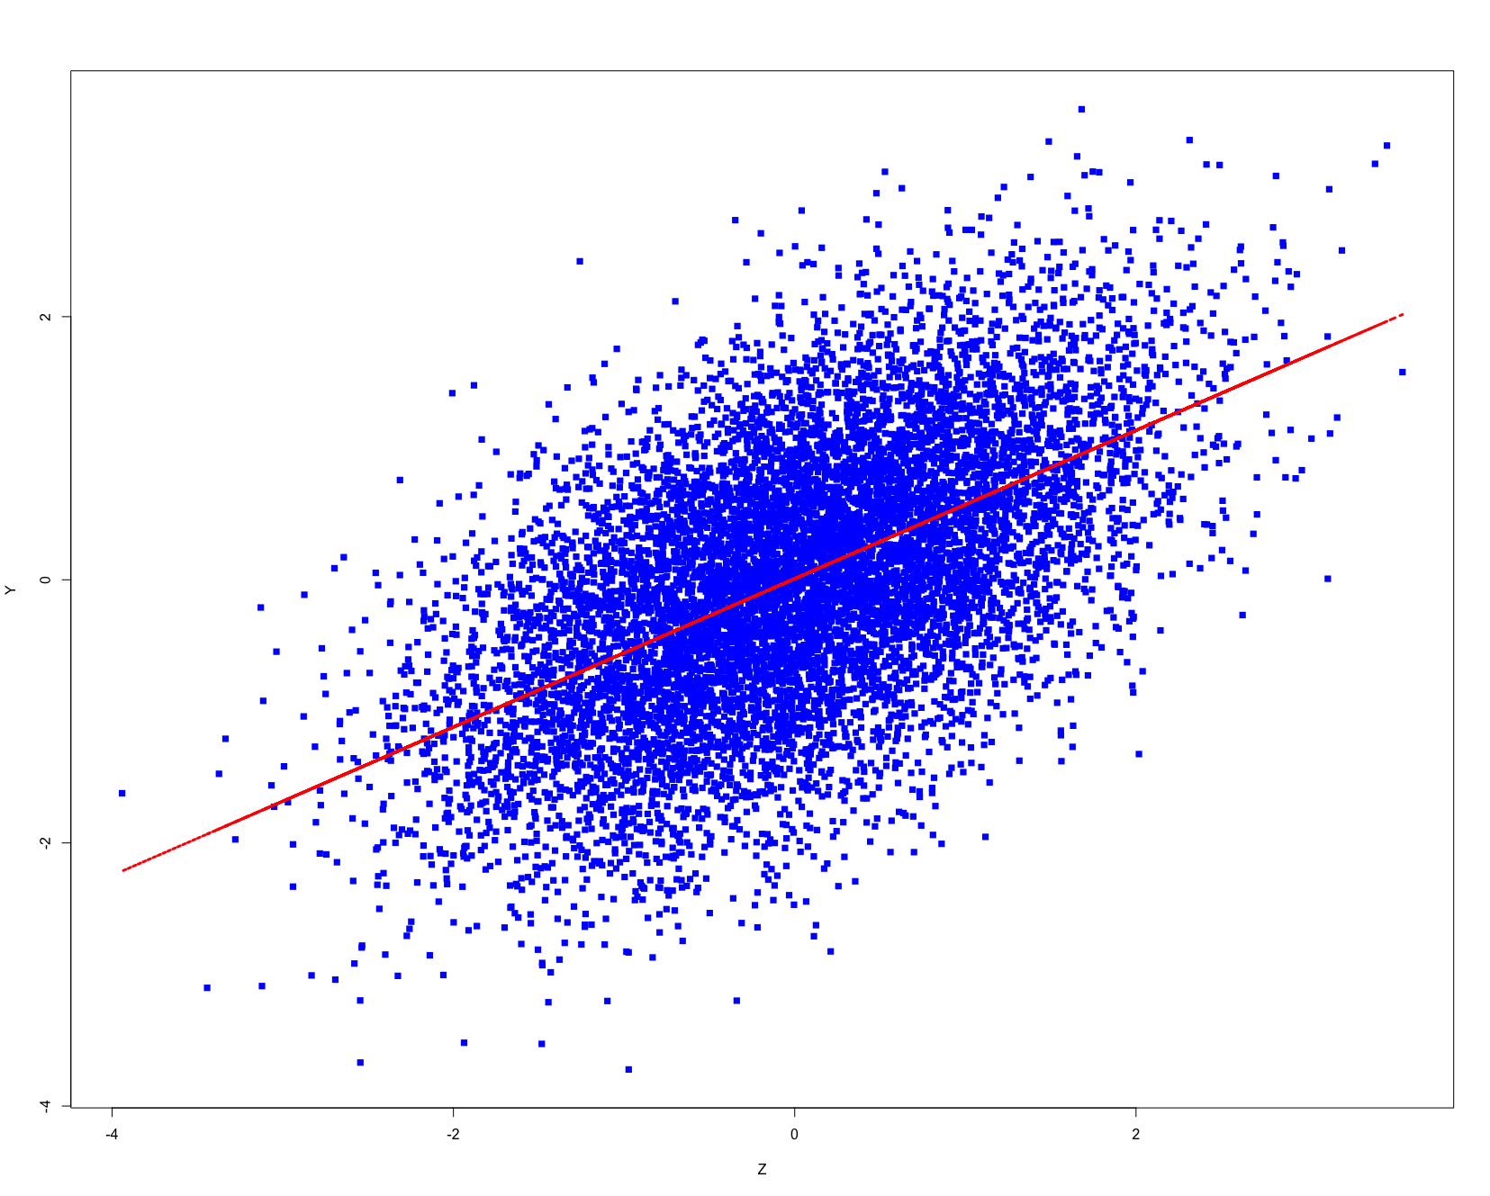

Slide 111
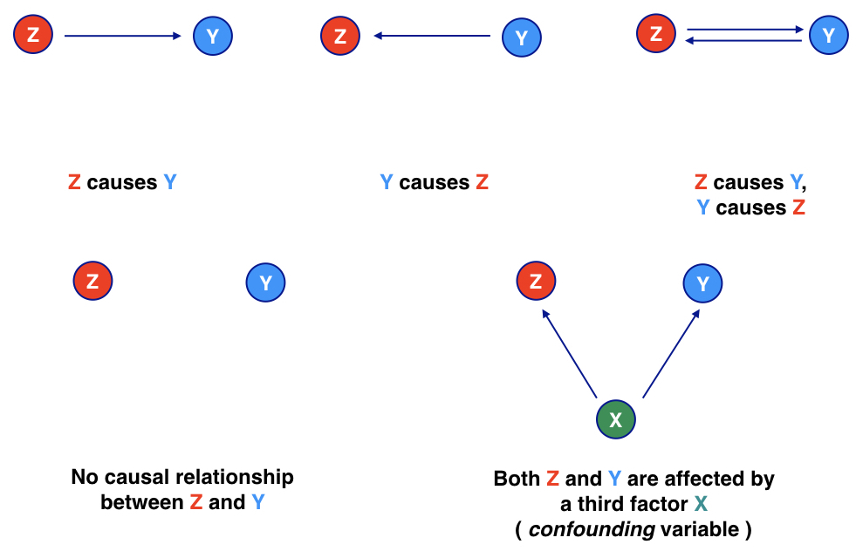

Slide 112
Correlation does not mean causation!

